Slide 1

Soteria: Provable Defence againstPrivacy Leakage in Federated Learning from Representation Perspective
Conference CVPR, June 2021
Guided by:-
Prof. C Krishna Mohan
Presenter :-
Parth Thakkar
CS22MTECH14005
Teaching Assistant :-
Zarka Bashir
Research Scholar,
IIT Hyderabad

Slide 2
Contents
1)Recap of Presentation 1
2)Original Results
3)Reproduced Results(For Heart Failure dataset)
3)Novelty ideas and future work
4)Conclusion and observations
5)References

Slide 3
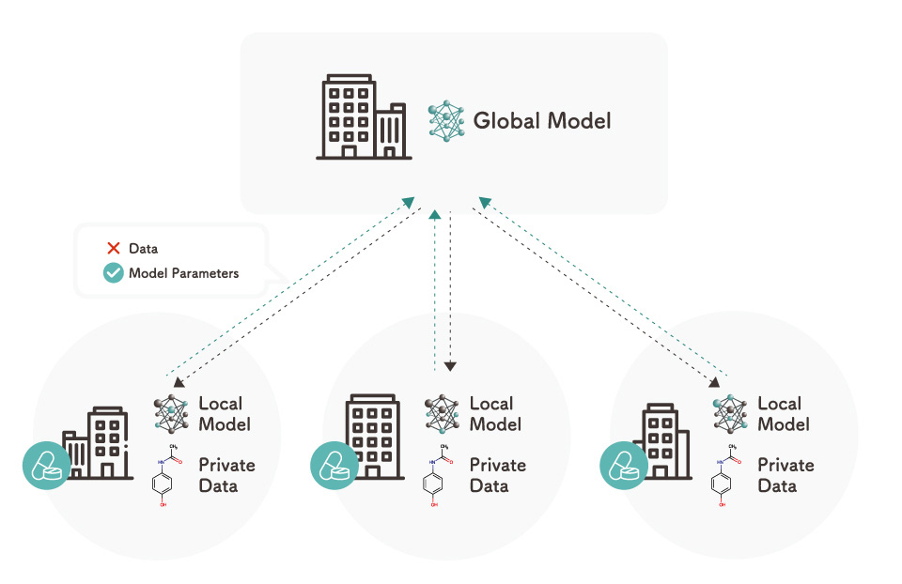
Recap of Presentation 1.
Federated Learning:-
Federated Learning is simply the decentralized form of Machine Learning.
Here, we train a centralized Machine Learning model on decentralized data!
Federated Learning

Slide 4
Differential Privacy:-
Firstly, Why differential privacy?
could we just anonymize the data by hiding the features that reveal the identity?
but there is an issue!
In 2006, Netflix announced a competition called “Netflix Price”, in which Teams had to predict how someone would rate the movie out of 5 stars, Netflix provided the dataset with over 100 Million ratings and anonymized them
But 2 scientists, Arvind Narayanan and Vitaly Shmatikov from the University of Texas published a paper known as “Robust De-anonymization of Large Sparse Dataset”, which claimed that they have successfully identified the people by combining the dataset with IMDB
These attacks are known as Linkage attacks
Robust De-anonymization of Large Sparse Dataset

Slide 5
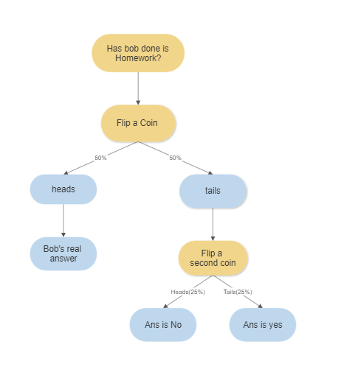
How Differential Privacy works(A simple example of a Randomized algorithm)
We want the answer that how many people do their homework.
We setup a survey that has a question “have you done your homework?”

Slide 6

ε-differential privacy
Let ε be a positive real number
Let “A” be a randomized algorithm that takes a dataset as input
D1,D2 are the datasets that differ by atmost one entry
S is the set of all subsets that algorithm A will give as an output

Slide 7
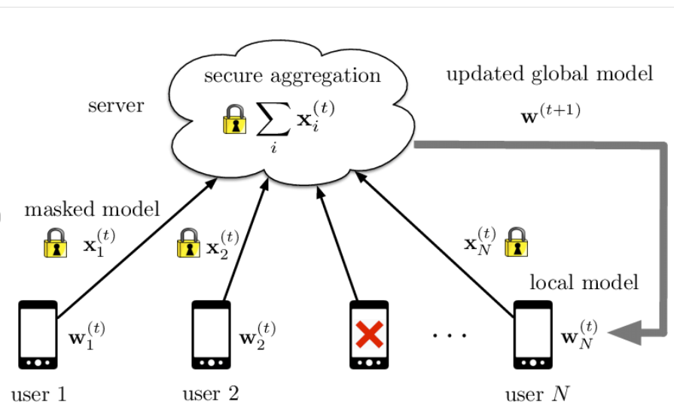
Secure Aggregation:-
It is a secure multi-party computation (SMPC) protocol, that enables a centralized server to compute the sum of values submitted by several clients, without learning the values themselves.
In the context of federated learning, each client’s update can be represented as a tensor of values, and secure aggregation enables the federated learning orchestration server to compute the sum of many client’s update, without accessing the values themselves
Secure aggregation in federated learning.

Slide 8


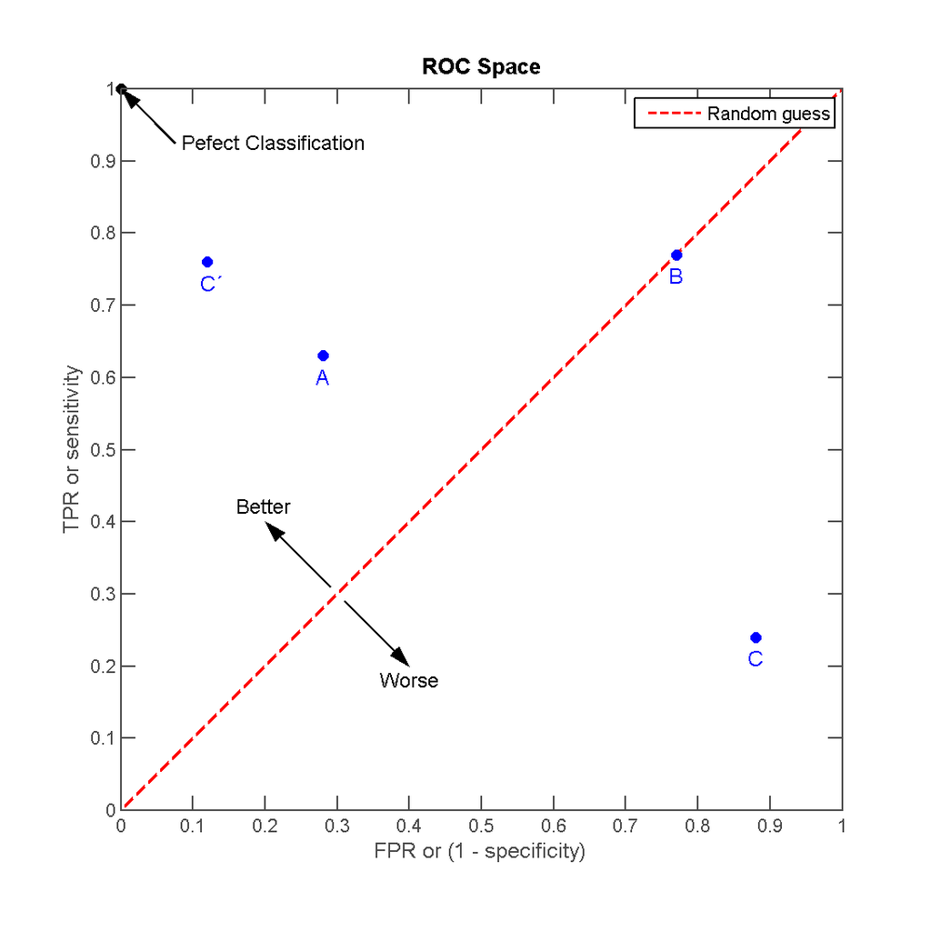
AUC-ROC Metric for classification task
Basically, ROC curve is a graph that shows the performance of a classification model at all possible thresholds
The true-positive rate can be interpreted as the probability of detection
The false-positive rate can be interpreted as the probability of false alarm
Receiver operating characteristic - Wikipedia

Slide 9
Motivation
Most health research to date uses data stored in a centralized database (i.e., a database stored in a single site), where analysis and model fitting is done with full access to the sensitive underlying data
Federated learning techniques enable calculation of research study endpoints in a privacy-preserving fashion such that private data never leaves a given device
With these advantages, large fractions of the population that wanted to contribute to novel health findings, but had reservations about sharing raw data and digital signals, Now will contribute towards the same without any hesitations

Slide 10
Problem Statement
We are given n clients a1 , a2 , ..., an in which each client ai has in its own control local data Di . There is a central coordinator, C (the server). Our goal is to design a learning algorithm A that serves as a gradient-based learning algorithm to produce a machine learning model across all participating clients. The clients only send (differentially private) gradients back to the central coordinator. The method requires that Di not be revealed to C.

Slide 11
Existing method(s)/Related work with limitations
For the health care research Federated Learning has been deployed:-
Limitation:-
prior studies have not fully considered privacy, which is not guaranteed by default in an arbitrary federated learning setup, and needs to be treated,implemented, and studied explicitly

Slide 12
Paper Methodology
Our work demonstrates the successful use of federated learning in the presence of homogeneous data silo settings(i.e., where the output of federated computation from one data silo is composable with the output from another silo).
rather than developing a custom technique to federate learning of one specific class of models as done in prior work, we demonstrate how such encompassing work can be achieved within the unified framework of TensorFlow
We will use Logistic Regression and DNN models for our testing

Slide 13
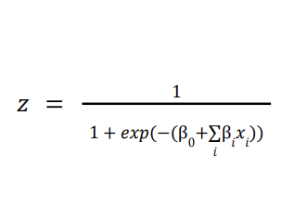
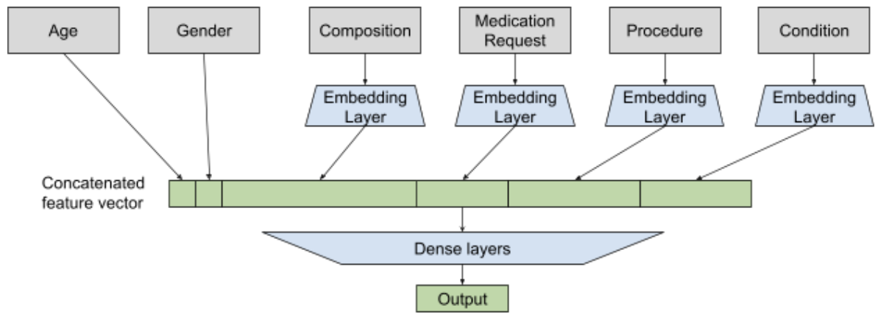
Logistic Regression Model:-
Deep Learning Model:-

Slide 14
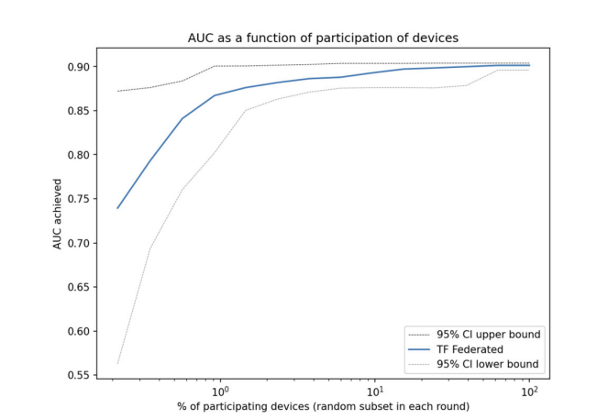
Since in general in the federated setting not all participants may be available at any one time, we explore model quality as a function of subjects’ participation rate. Across the datasets, we find that only a minority of clients need to participate in any one round
Area under the ROC curve (AUC) as a function of fraction of participants in each federated (server) round of learning for replicated model of SARS-CoV-2 and Cancer

Slide 15
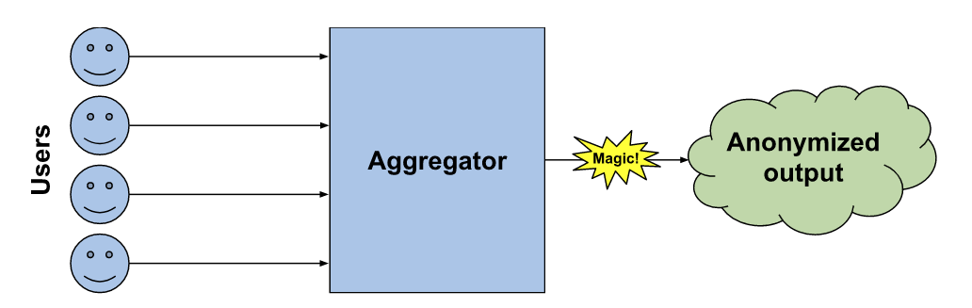
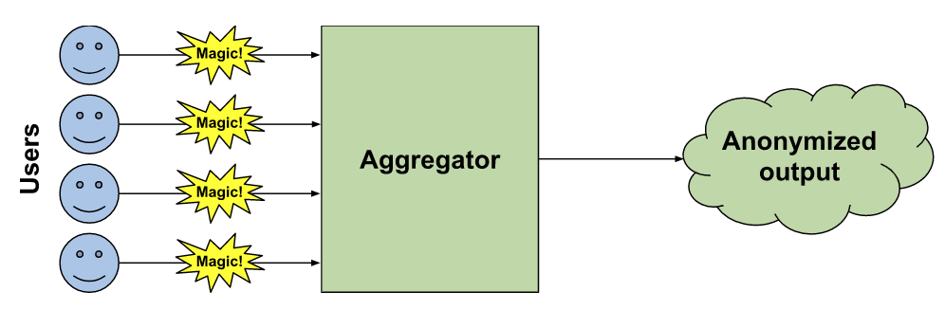
In this work we are using 2 Models of Differential Privacy
1)Central Model:-
2)Local Model:-
Local vs. central differential privacy

Slide 16
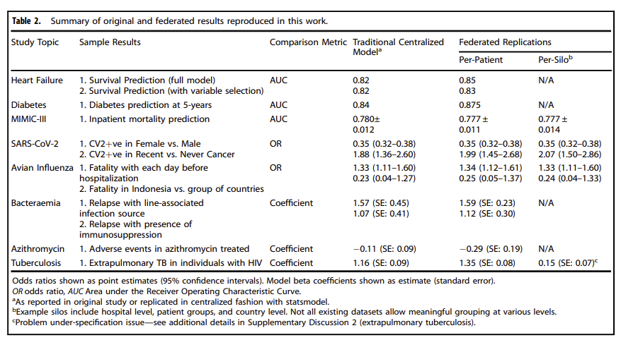
Original Results
In this work we are using 8 different datasets whose summary is given in the table below

Slide 17
Heart Failure
The Heart Failure Clinical Records Dataset from the University of California Irvine data repository involves 299 individuals with left ventricular systolic dysfunction and class III or class IV heart failure ranging from 40 to 95 years of age.
Our federated setting achieves 0.85 AUC(0.82 in the original work)
The higher AUC score in our setting is due to the addition of regularization while optimizing model parameters
Adding a central differential privacy module reduces AUC to 0.83
With local DP, the federated architecture achieves 0.82 AUC

Slide 18
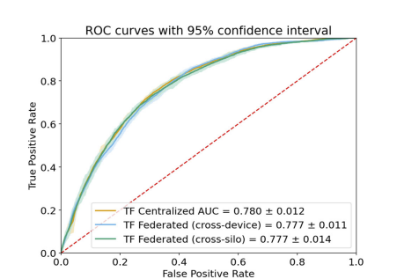
MIMIC-III
MIMIC-III is a large, freely-available database comprising de identified health-related data associated with over 40,000 patients who stayed in critical care units of the Beth Israel Deaconess Medical Center between 2001 and 2012
Each patient in the dataset has a time series of medical encounters involving procedures, medications, diagnoses and other complex signals, such as medical notes

Slide 19
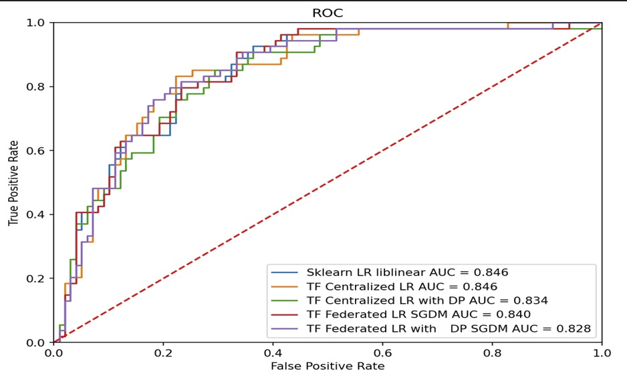
Reproduced Results
Results obtained while implementing FDP on Heart Failure dataset

Slide 20
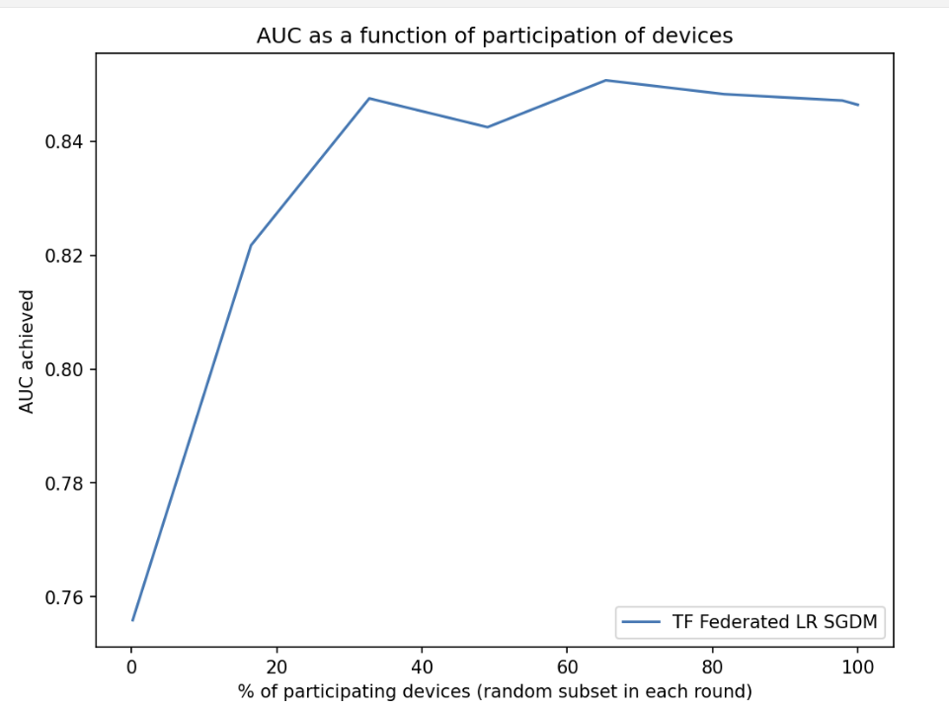
Representing AUC as a function of Percentage of clients participating

Slide 21
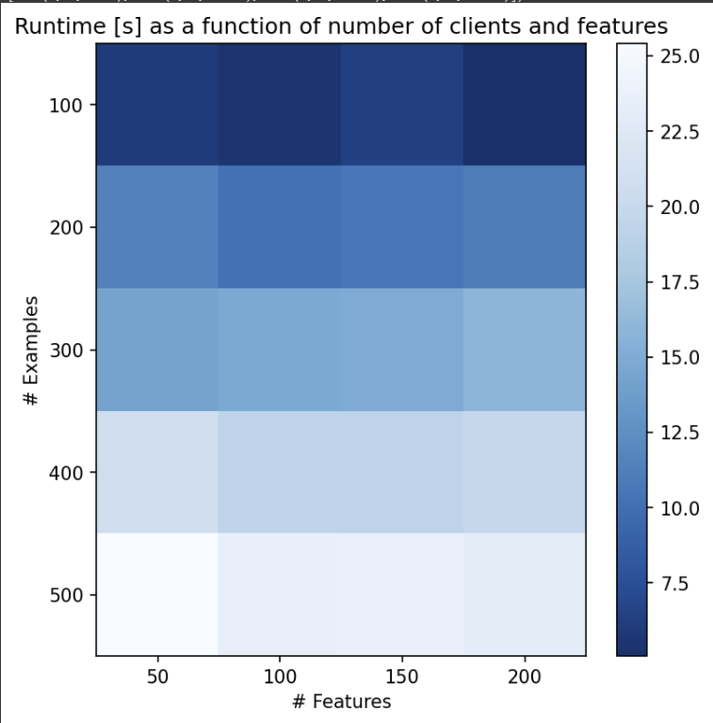
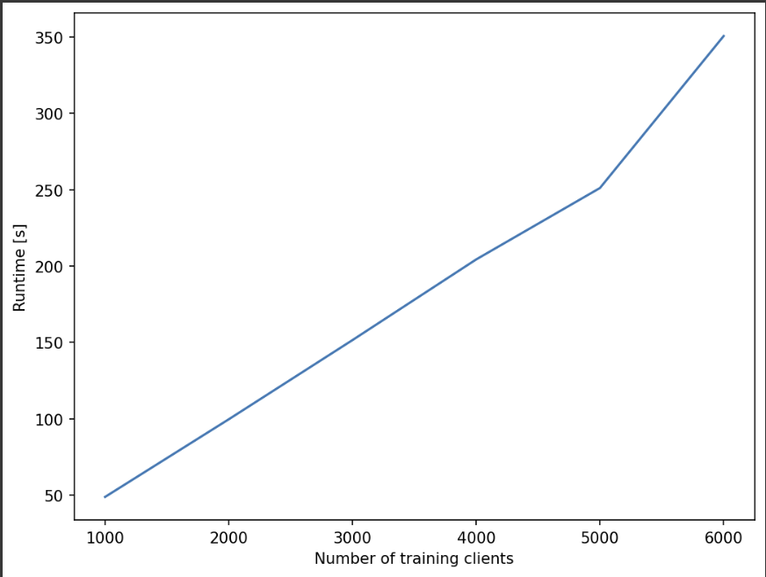
Analysing the runtime of our work

Slide 22
Novelty ideas and future work
I am thinking of introducing utility-optimized federated learning along with differential privacy in the field of Health care research.
I have referred to the paper “[1]Utility Optimization of Federated Learning with Differential Privacy (hindawi.com)” for this idea
The main challenge of federated learning with differential privacy is to strike a balance between utility and privacy.
Smaller value of epsilon will ensure a great privacy-preserving system but, in turn will impact the utility of the system significantly and a bigger value of epsilon will have a less privacy-preserving system but the utility of our system will be great.
[1]Utility Optimization of Federated Learning with Differential Privacy (hindawi.com)

Slide 23
What is the issue with Traditional methods used for FDP learning, and what will be our approach to improve upon it?
Existing differentially private methods allocate the same amount of privacy budget for each participant and each iteration in model updating.
which leads to ubiquitous trade-off problems between privacy and utility
This problem is mainly because federated learning is a complex training process with many participants and iterative updating, aggregation, and broadcasting. The guarantee of its privacy comes from adding a certain amount of noise at each communication
We will tackle this issue by allocating privacy budgets for different participants dynamically.

Slide 24
Steps of our method
1)Initialization:
the collaborator initializes global model parameters such as learning rate, batch size, and noise parameter
2)Participant selection:
the collaborator evaluates the available participants and, according to the optimal indicator, decides who is selected to join in the current training round of federated learning
3)Parameter broadcast:
the collaborator broadcasts the global model and the noise parameters of the current round to the selected participants.
4)Local model update:
the participant privately and locally performs a round of model training by adding random Gaussian noise to the local weights based on the local data.
5)Local models upload and aggregation:
the selected participants upload the private local model to the collaborator
6)Noise scale adjustment:
the collaborator obtains verification accuracy to verify the global model convergence situation and decides whether adjusting the noise parameter or not in the current predetermined dynamic adjustment round. If so, an adjusted noise parameter will be broadcast in the next training round

Slide 25
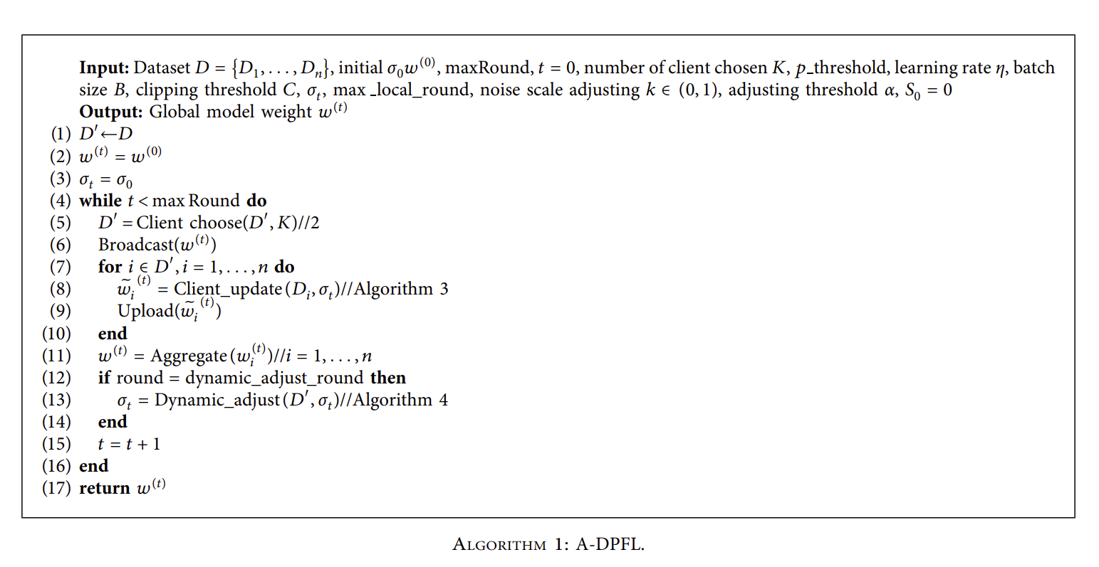
Adaptive Differentially private federated learning algorithm

Slide 26
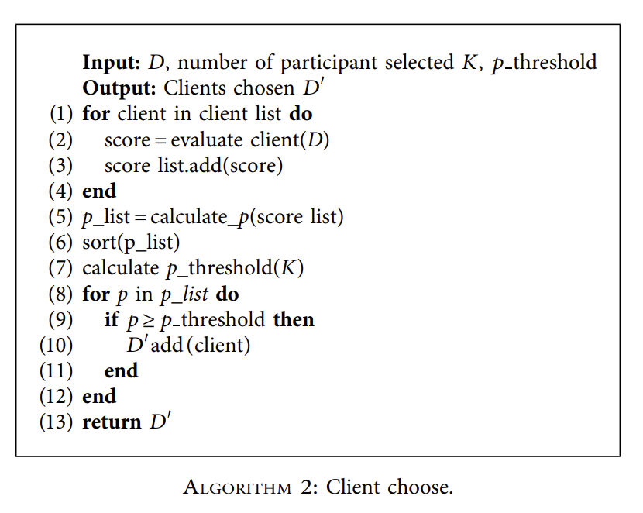

Slide 27
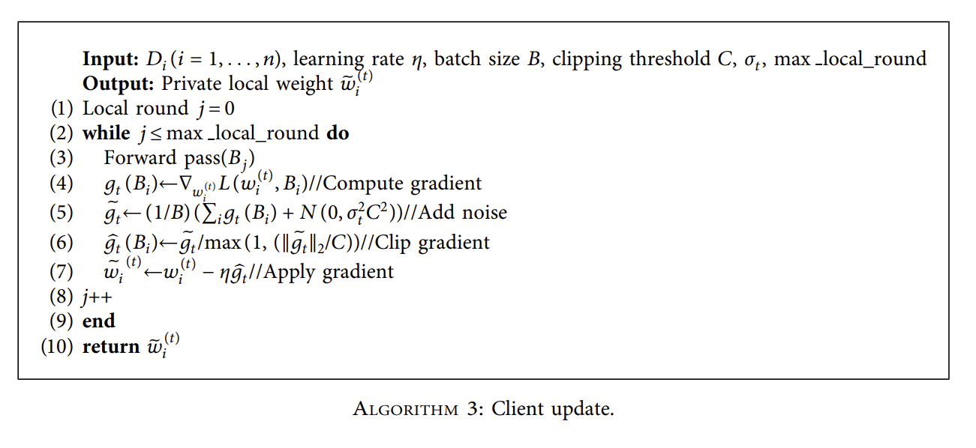

Slide 28
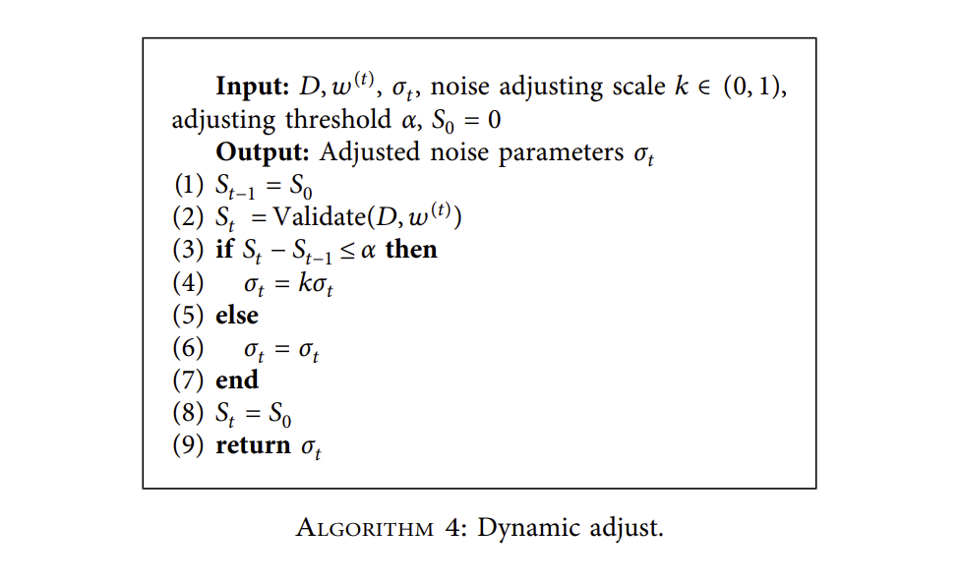

Slide 29
Observations and Conclusion
Using the methods like differential privacy and secure aggregation in tandem with federated learning, we can ensure better privacy without much loss of performance, and regularization can help the cause.
Adaptive Differentially private federated learning can further help to reduce the difference between FL with and without DP by striking a balance between utility and privacy.
Integrating DP with CL-FL(FedweIT)(Ongoing)

Slide 30
References
[1] Zhu, W., Kairouz, P., Sun, H., McMahan, B. & Li, W. Federated heavy hitters with differential privacy. Proceedings of the Twenty Third International Conference on Artificial Intelligence and Statistics. PMLR 108, 3837–3847 (2020).
[2] Choudhury, O. et al. Predicting adverse drug reactions on distributed health data using federated learning. AMIA Annu. Symp. Proc. 2019, 313–322 (2020). eCollection 2019.
[3] Johnson, A. E. W. et al. MIMIC-III, a freely accessible critical care database. Sci. Data 3, 160035 (2016)
[4] Bonawitz K. et al. TensorFlow federated: machine learning on decentralized data. (2020). https://www.tensorflow.org/federated (accessed Nov 2020)
[5] Bonawitz K. et al. Practical secure aggregation for privacy preserving machine learning. In Proceedings of ACM Conference on Computer and Communications Security (ACM CCS). (2017).
[6] Video to understand Differential Privacy:-(160) Differential Privacy - Simply Explained - YouTube
[7] R. C. Geyer, T. Klein, and M. Nabi, “Differentially private federated learning: a client level perspective,” 2017, http:// arxiv.org/abs/1712.07557.

Slide 31
[8]Jianzhe Zhao, Keming Mao, Chenxi Huang, Yuyang Zeng, "Utility Optimization of Federated Learning with Differential Privacy", Discrete Dynamics in Nature and Society, vol. 2021, Article ID 3344862, 14 pages, 2021. https://doi.org/10.1155/2021/3344862
[9] Geyer R. C., Klein T., Nabi M. Differentially private federated learning: a client level perspective. arXiv 2017; published online Dec. http://arxiv.org/abs/1712.07557 (Accessed 23 Nov 2020).[10] Choudhury, O. et al. Predicting adverse drug reactions on distributed health data using federated learning. AMIA Annu. Symp. Proc. 2019, 313–322 (2020). eCollection 2019.
[10] Ramage D. & Mazzocchi S. Federated analytics: collaborative data science without data collection. Google AI Blog. (2020). https://ai.googleblog.com/2020/05/ federated-analytics-collaborative-data.html (Accessed Nov 2020).[4] Bonawitz K. et al. TensorFlow federated: machine learning on decentralized data. (2020). https://www.tensorflow.org/federated (accessed Nov 2020)

